Slide 1
Fulfilling the great vow for kosen-rufu is the essential spirit of Soka mentors & disciples
May 2021 Diamond Chapter Gosho Study

Slide 2
Sensei carrying on the mission
On 3 May 1960, Daisaku Ikeda was inaugurated as the third president of the Soka Gakkai

Slide 3
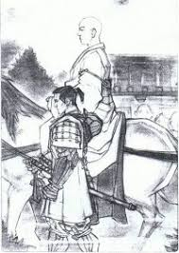
This I will state. Let the gods forsake me. Let all persecutions assail me. Still I will give my life for the sake of the Law.

Slide 4
How do we uphold our vow
The most important thing in faith is a spirit of non-regression. One must not regress in deed, word or thought. Refusing to cease our struggle for as long as we live - this is the spirit of Nichiren Buddhism and the heart of the Soka Gakkai.

Slide 5
Our spirit activates the protective functions
Nichiren Buddhism is not a teaching longing for or simply relying upon heavenly protection. Nor is it a ‘dependent faith’ seeking salvation from a supernatural power of beings. Rather, it teaches us to have unwavering faith in the Lotus Sutra, to dedicate our lives to the spread of the Mystic Law and to confront and come to term with the hardest and most trying circumstances.

Slide 6
Since hatred and jealousy toward this sutra abound even when the Thus Come One [Shakyamuni Buddha] is in the world, how much more will this be so after his passing?
Difficulties are a badge of honour

Slide 7
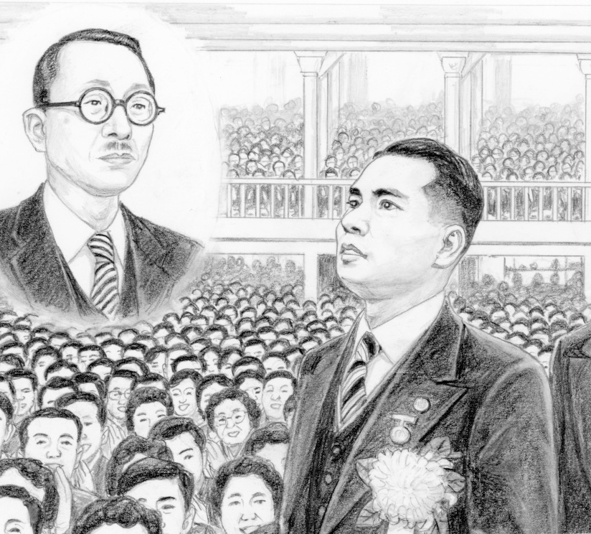
Let’s press forward each year aiming for May 3, Soka Gakkai Day

Slide 8
Be the pillar of the eye, be the great ship of world peace
Point Two, on the persons who ‘have fulfilled their great vow, … because they pity living beings, they are born in this evil world so they may broadly expound this sutra’. The Record of the Orally Transmitted Teachings says: The ‘great vow’ refers to the propagation of the Lotus Sutra. ‘Because they pity living beings’ refers to all the living beings in the country of Japan. The persons who ‘are born in this evil world’ are Nichiren and his followers. ‘Broadly’ means to expound the sutra throughout the southern continent of Jambudvipa [the entire world]. ‘This sutra’ refers to the Daimoku. Now the above passage to Nichiren and his followers, who chant the Daimoku, Nam-myoho-renge-kyo.

Slide 9
The Great Teacher Miao-lo – articulated the principle of “voluntarily assuming the appropriate karma.”
Karma – refers to causes made in the past lifetime that lead us to be born in a particular place.
Voluntarily - indicated our vow as Boddhisatva to be born in an evil age to relieve the suffering of all living beings.

Slide 10
Adversity – an opportunity for changing our karma.
Through earnest battling karmic challenges, we can develop ourselves and become deeply compassionate understand other’s suffering and encourage them – demonstrating that those who suffer the most can become the happiest.

Slide 11
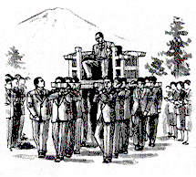
What is kosen-rufu?
The process of purifying the negative ideas and thinking that prevail in the latter day of the Law, a corrupted age like the present, with the truth of Nam-myoho-renge-kyo.
The ultimate expression of hope, by putting the teachings of the Mystic Law into practice in society, calamities such as war, famine and epidemic would be eradicated and people would be able to enjoy happy and secure lives.

Slide 12
The eternal vow of the Soka Gakkai
To be the pillar of:
Human harmony, praying for people’s security and happiness and working to realise the Daishonin’s ideal of establishing the correct teaching for the peace of the Land, the starting point for world peace.
The eyes of hope – penetrating and illuminating the darkness and confusion of an age lacking a solid life philosophy and showing people the way to joy in life and lasting happiness for both themselves and others.
The great ship of assurance – championing the principles of respect for life and human dignity, valuing each individual and leaving no one behind.

Slide 13
Let us cause the sun of our vow for kosen-rufu to rise in our hearts as we keep moving forwards with optimism, wisdom and courage on our path of human revolution and our eternal voyage of mentor and disciple!

